Slide 1
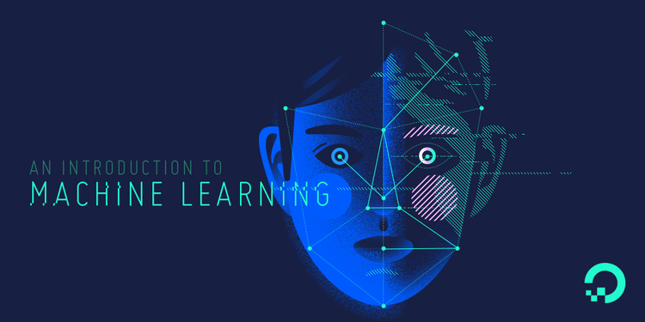

Slide 2
Level of Product
Early 1950 Optimism began
Artificial Intelligence
1980’s Machine Learning begins to flourish
Machine Learning
2010 Deep Learning breakthroughs
Deep Learning

Slide 3
Machine learning is a field of computer science that gives computers the ability to learn without being explicitly programmed.
—Arthur Samuel, 1959

Slide 4
“Classical” decision making
(explicit instructions)
Requires ‘a priori’ knowledge
Feature | Input | Procedure | Output
F0 | [0.8] | if F1 > 0.5 and F2 * F3 < 0.3: if (F4 – F5) / F6 < 1: do A else: if F7 * F0 < 0.3: do B else: do C else: do D | “A”
F1 | [0.2]
F2 | [0.9] |  | “B”
F3 | [0.2]
F4 | [0.0] |  | “C”
F5 | [0.4]
F6 | [0.3] |  | “D”
F7 | [0.1]

Slide 5
ML decision making
Requires no (or very little) ‘a priori’ knowledge
Feature | Input | Procedure | Output
F0 | [0.8] | Output = MATRIX * Input (Linear Regression) Output = g( M2 * f( M1 * Input) ) (Neural Network with one hidden layer) | “A”
F1 | [0.2]
F2 | [0.9] |  | “B”
F3 | [0.2]
F4 | [0.0] |  | “C”
F5 | [0.4]
F6 | [0.3] |  | “D”
F7 | [0.1]

Slide 6
Applications of Machine Learning
Data Mining – Web Click Data, Medical Records, Diagnosis
Financial Predictions, Fraud Detections
Player ranking in online games
Computer vision (barcode, fingerprint and number plate readers)
Churn Prediction, Customer Behaviour Analysis
Voice recognition, Handwriting Recognition

Slide 7
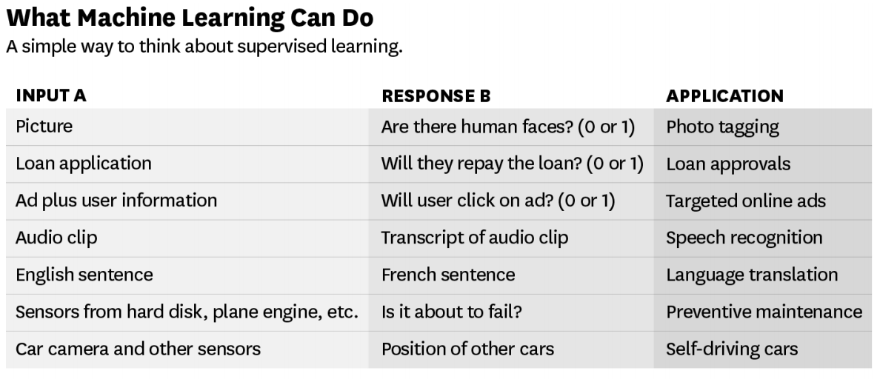
Source – ANDREW NG

Slide 8
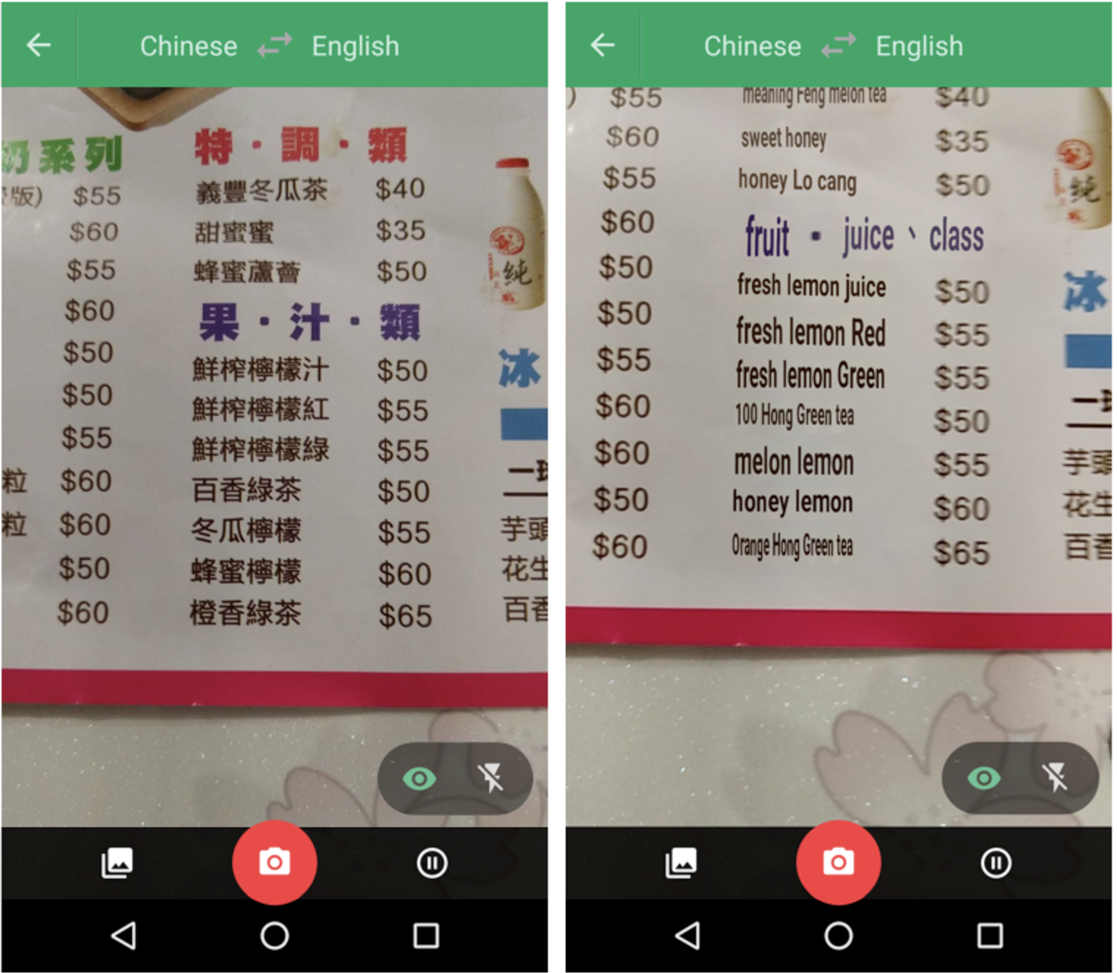
!!
Point your camera at the menu during your next trip to Taiwan and the restaurant’s selections will magically appear in English via the Google Translate app.
Google Translate overlaying English translations on a drink menu in real time using convolutional neural networks.

Slide 9
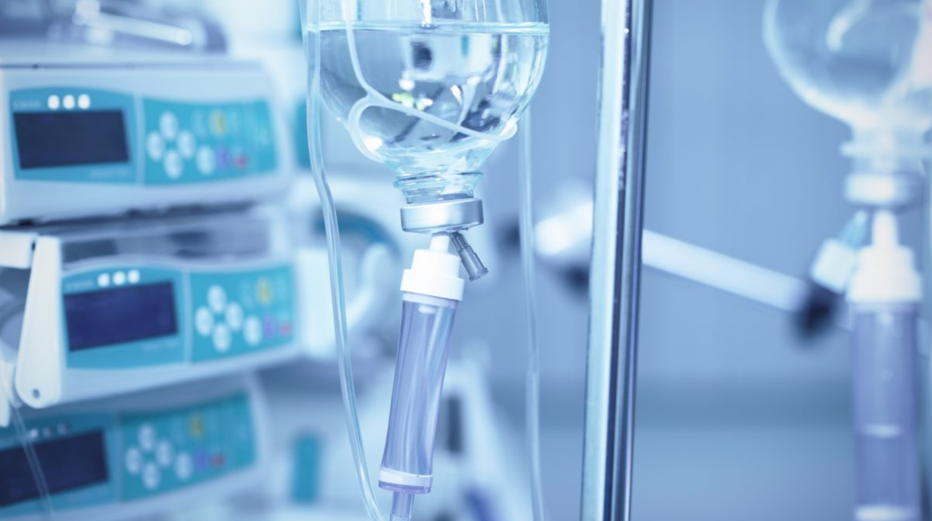
MIT USES DEEP LEARNING TO HELP GUIDE DECISIONS IN ICU
“The ICU is a high-stakes, high-demand environment, and doctors can spend only a limited amount of time with each patient,” said Suresh a doctoral student at MIT.
“When doctors are dealing with many data sources and data types, computational tools can make a difference.”
If put into practice, ICU Intervene could help doctors more quickly choose the right treatment for each patient, Suresh said. It could also avoid unnecessary treatments.
Source: https://blogs.nvidia.com/blog/2017/10/02/the-ai-will-icu-now-deep-learning-helps-guide-decisions-in-intensive-care/

Slide 10
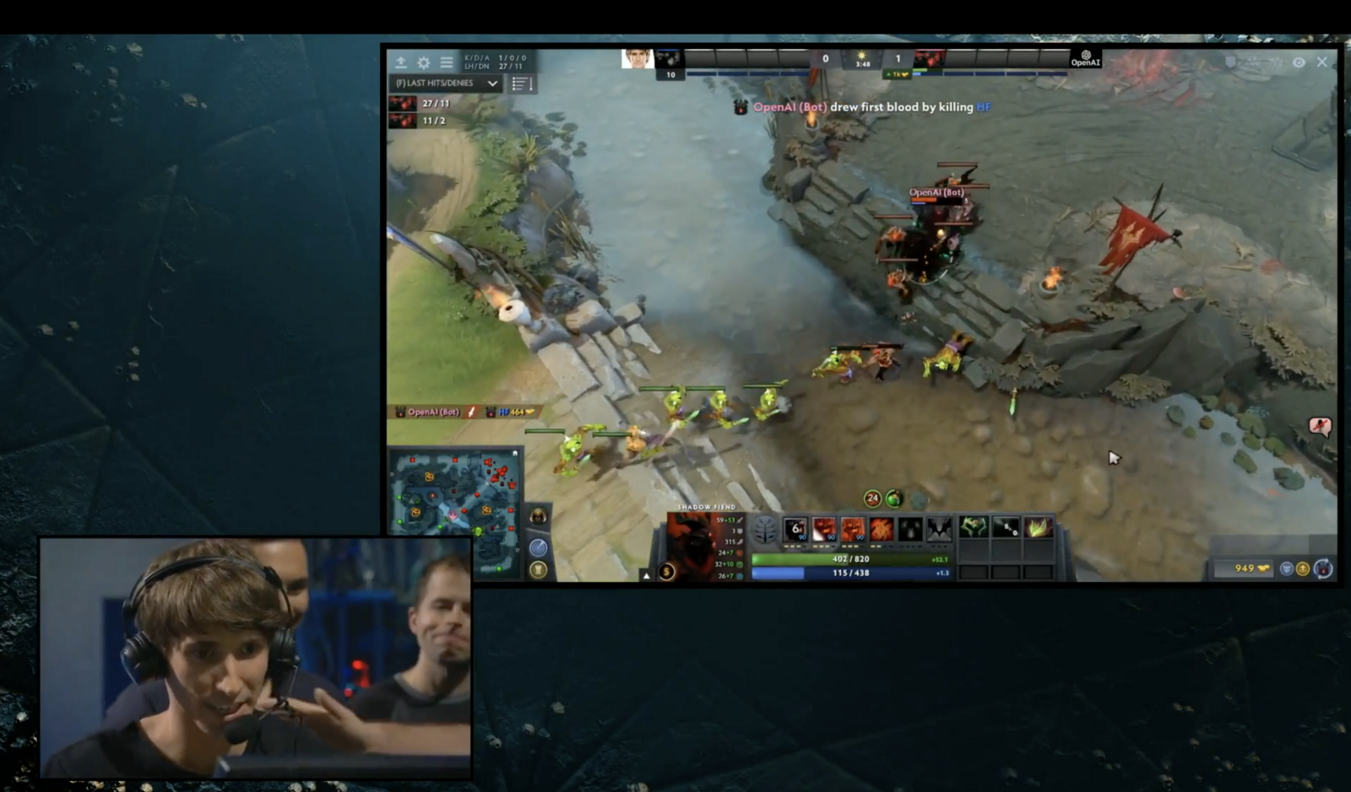
!!
Just a few months on August 11, 2017, OpenAI
reached yet another incredible milestone by
defeating the world’s top professionals
in 1v1 matches of the online multiplayer game Dota 2.

Slide 11

!!
How machine learning is helping Virgin boost its frequent flyer business
Virgin Australia is looking to build models that can predict the types of people that are more likely to travel, the types of travel people are likely to undertake, the prices that travellers are willing to pay, the importance of accommodation relative to travel, and the importance of experience compared to travel.

Slide 12
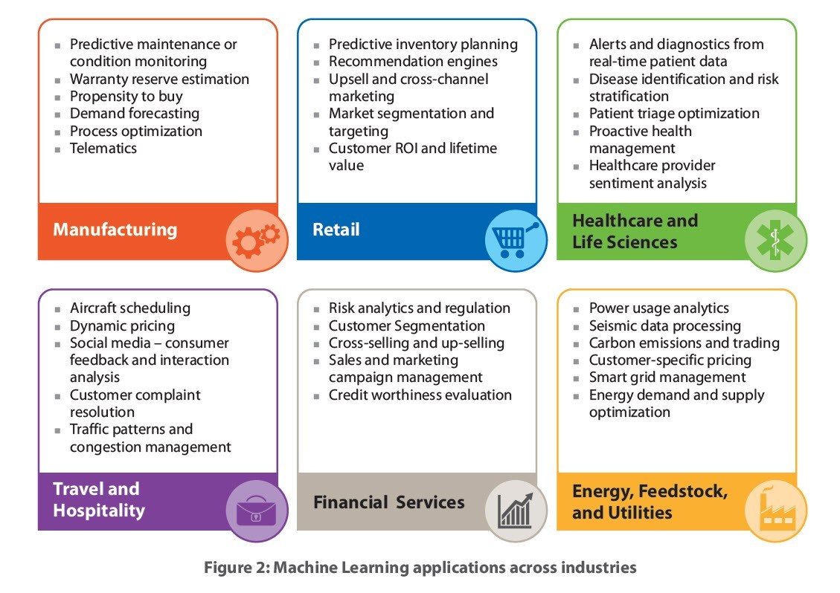

Slide 13
Machine Learning Cloud Platforms -
Microsoft Azure ML Studio
https://azure.microsoft.com/en-us/services/machine-learning-studio/
Amazon Machine Learning
https://aws.amazon.com/aml/
SAP Leonardo Machine Learning
https://www.sap.com/india/products/leonardo/machine-learning.html
Google ML Platform
https://cloud.google.com/products/machine-learning/
IBM Machine Learning
https://www.ibm.com/analytics/data-science/machine-learning

Slide 14
What to learn in machine Learning?
Programming and
Tools
30%
Python/R, spark etc.
The Math behind
Machine Learning
70%
Probabilistic Theory, Statistics and Linear Algebra

Slide 15
What to learn in Machine Learning?
Python for Machine Learning
Packages for Machine Learning – Tensorflow, keras etc.
Handling Big Data
Practice, practice & practice
Optimization, boosting Techniques
Statistics for Data Science
Math behind Machine Learning Algorithms

Slide 16
Objective of a Machine Learning Algorithm
Getting better at a task through practice
The act of remembering: data / experience
Generalisation, similarity and new inputs
Learning and flexibility: adaptation

Slide 17
Discovering patterns in unlabeled data.
Cluster similar documents based on the text content.
Learning based on feedback or reward.
Learn to play chess by winning or losing.
Learning with a labeled training set.
Email spam detector with training set of already labeled emails.
Supervised Learning
Unsupervised Learning
Reinforcement Learning

Slide 18
Supervised Learning
We know what we are trying to predict. We use some examples that we (and the model) know the answer to, to “train” our model. It can then generate predictions to examples we don’t know the answer to.
Examples: Predict the price a house will sell at. Identify the gender of someone based on a photograph.

Slide 19
Unsupervised Learning
We don’t know what we are trying to predict. We are trying to identify some naturally occurring patterns in the data which may be informative.
Examples: Try to identify “clusters” of customers based on data we have on them

Slide 20
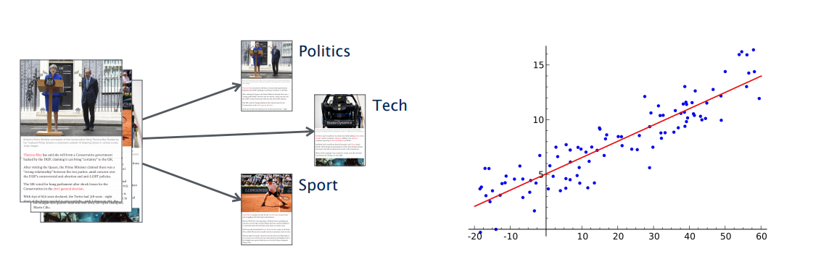
Types of Problems in Machine Learning -
Classification
Regression

Slide 21
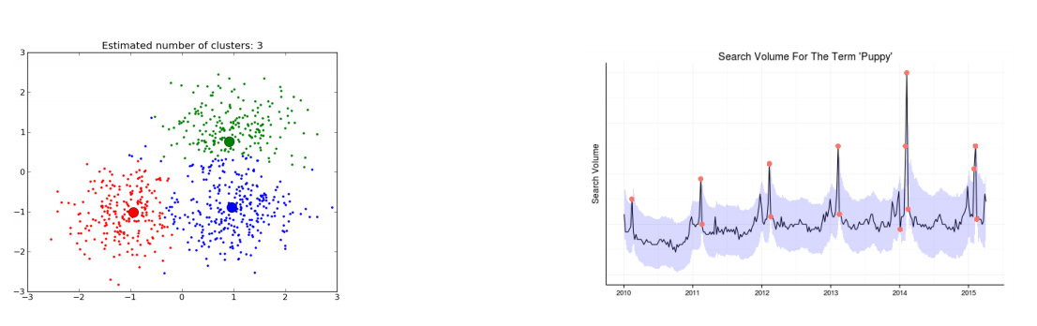
Types of Problems in Machine Learning -
Clustering
Anomaly Detection

Slide 22
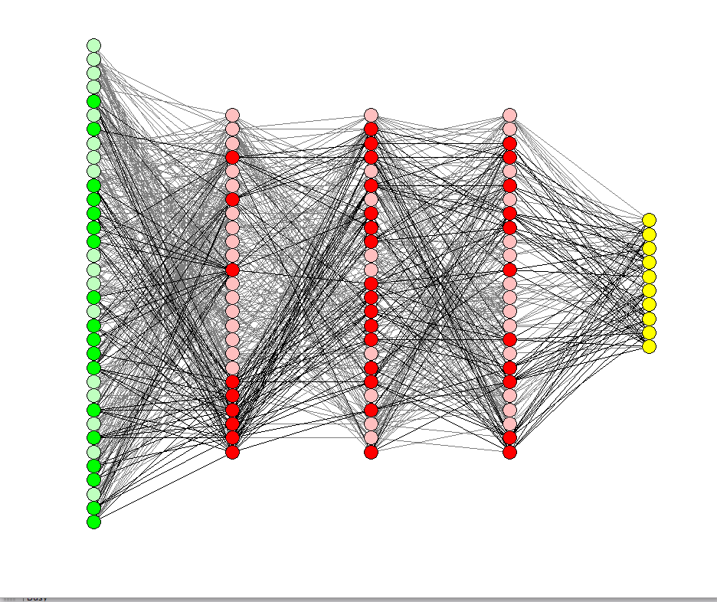
Deep Learning

Slide 23
Deep Learning
Deep Learning is part of the machine learning field of learning representations of data. Exceptional effective at learning patterns.

Slide 24
Happy Learning!
Stay Tuned for next exciting sessions on diving deeper into Supervised Learning

